Slide 1
Planning Network-Based Firewalls
Team Members:
E.Pravallika – 2010030046
Tahseen Begum – 2010030168
Keerthana Pulugam - 2010030445

Slide 2
Outline
Introduction
Implementation flow chart
Github commits
Work progress
Alpha testing

Slide 3
INTRODUCTION
The ASA (Adaptive Security Appliance) allows traffic to flow freely from an inside network (higher security level) to an outside network (lower security level). Here we can apply an access rule to limit traffic from inside to outside, or allow traffic from outside to inside.

Slide 4

Implementation flow chart
ASA
SERVER
Router
Switch

Slide 5
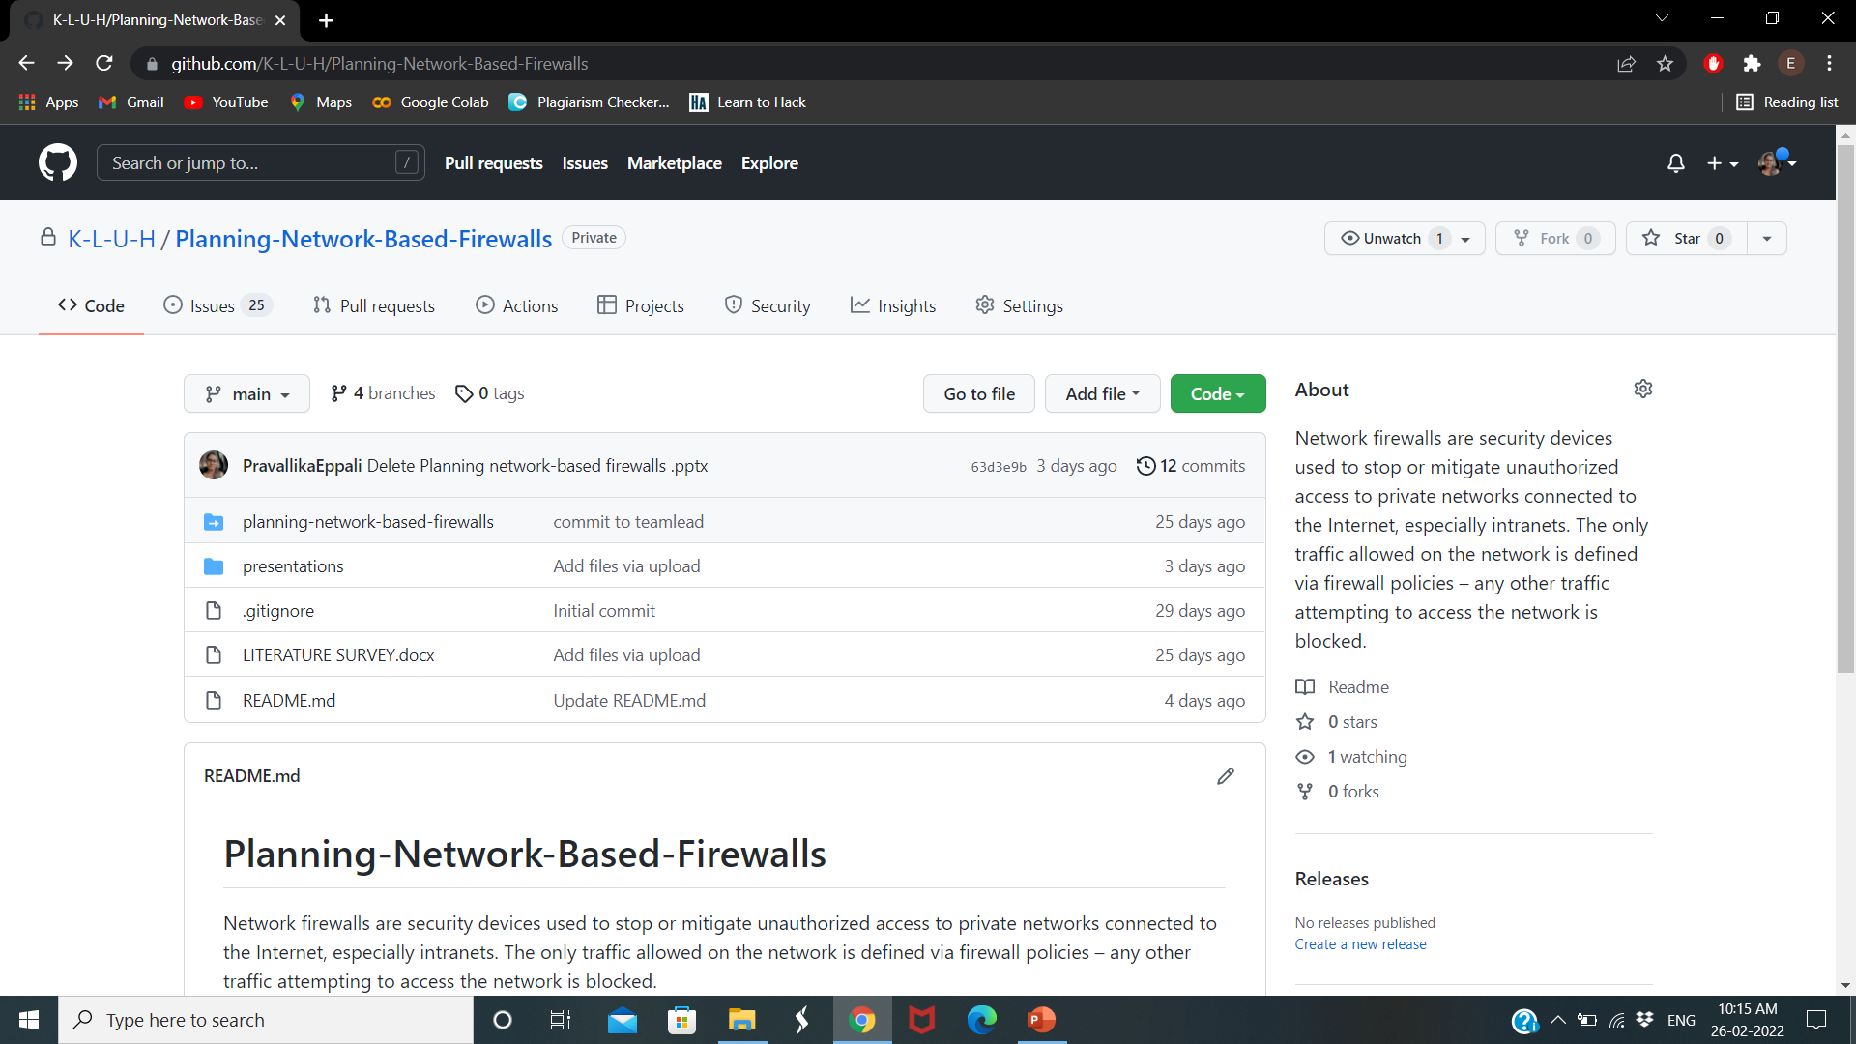
Github commits

Slide 6
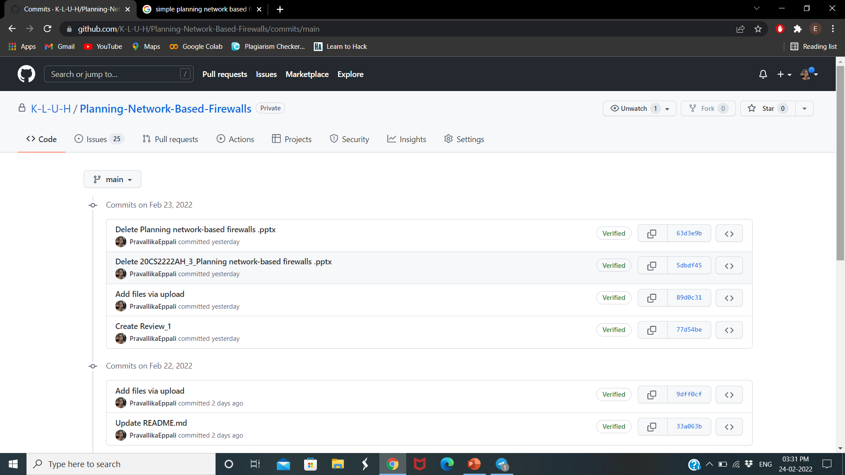

Slide 7
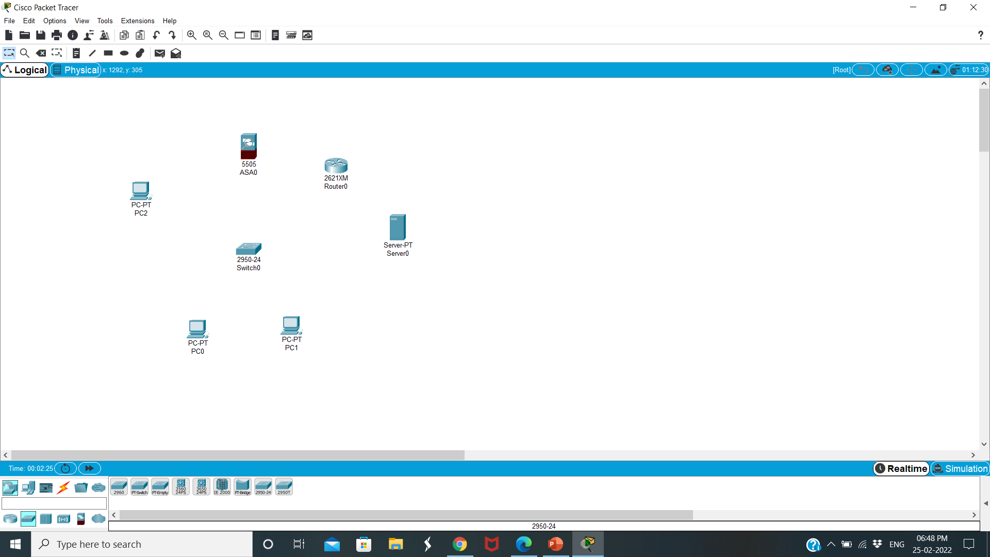
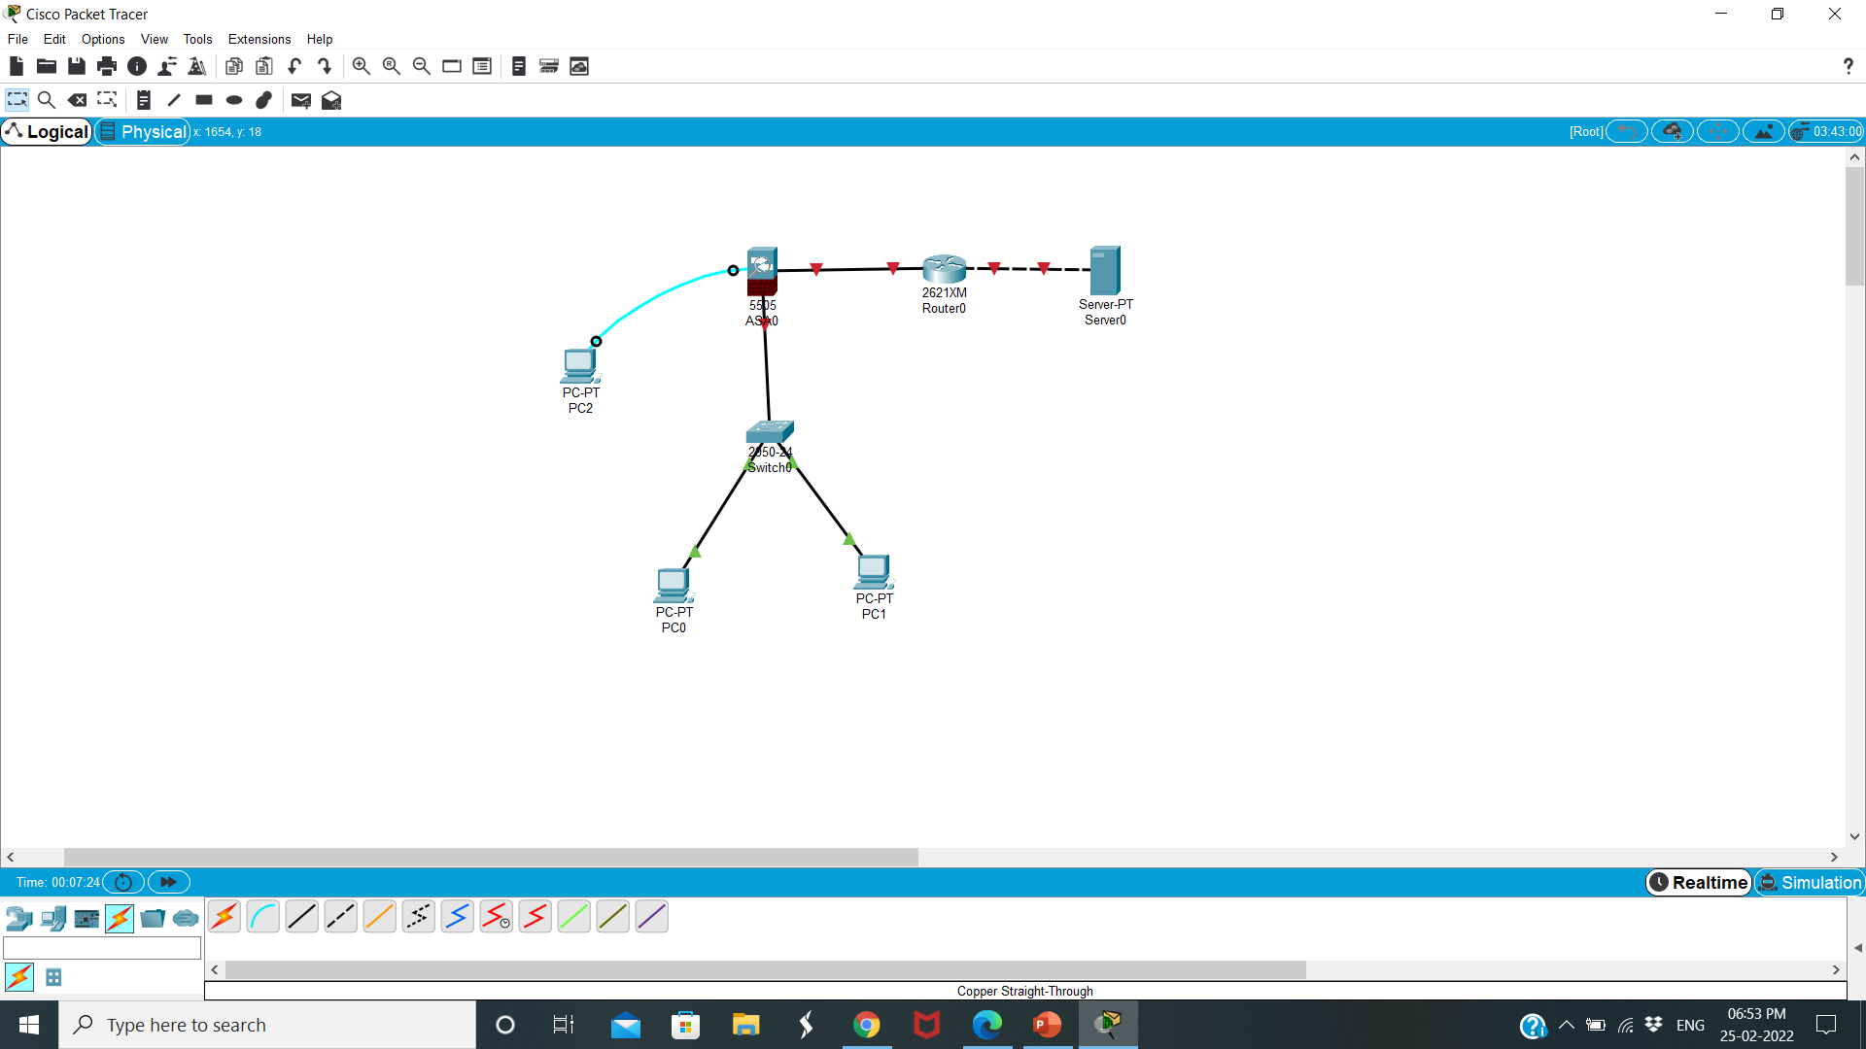
Work progress
Configuration of Cisco ASA Firewall

Slide 8
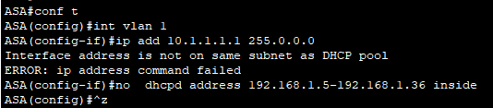

Assign IP According to ASA & ISP Router

Slide 9

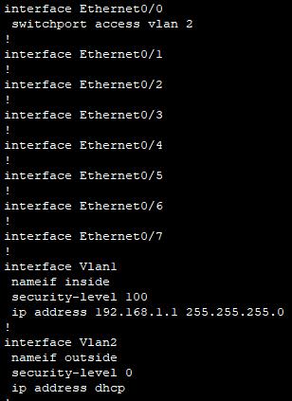
Set Inside and Outside on ASA Firewall

Slide 10

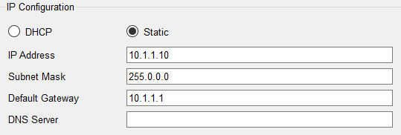
Configure DHCP Server and DNS IP ON ASA

Slide 11
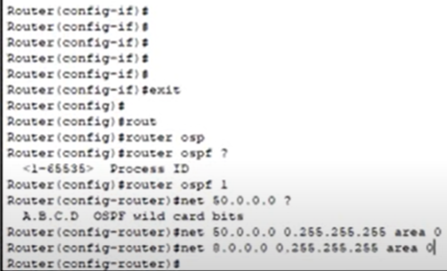
Configure Default Route on ASA
Configure OSPF on ISO Router

Slide 12
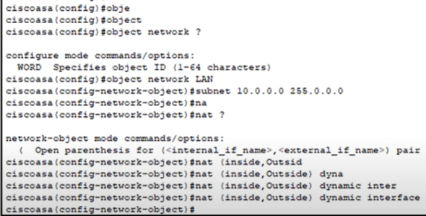
Create Object Network & Enable NAT on ASA

Slide 13
Alpha testing
We successfully connected between routers, switches using cables.
Then configured the IP According to ASA & ISP Router.
The access list to the ASA outside interface in the “IN” direction.
Finally firewall is successfully implemented.

Slide 14
THANK YOU

